Slide 1
Lecture2 Systems Development Life Cycle (SDLC) & Business Modeling
Reading: Main text, Chp2&4; Sup text, Chp 3&4
Lek Hsiang Hui

Slide 2
Outline
Predictive and Adaptive SDLC
SDLC Phases
Business Modeling
Intiation Phase (Intro)
Business Use Cases and Activity Diagrams

Slide 3
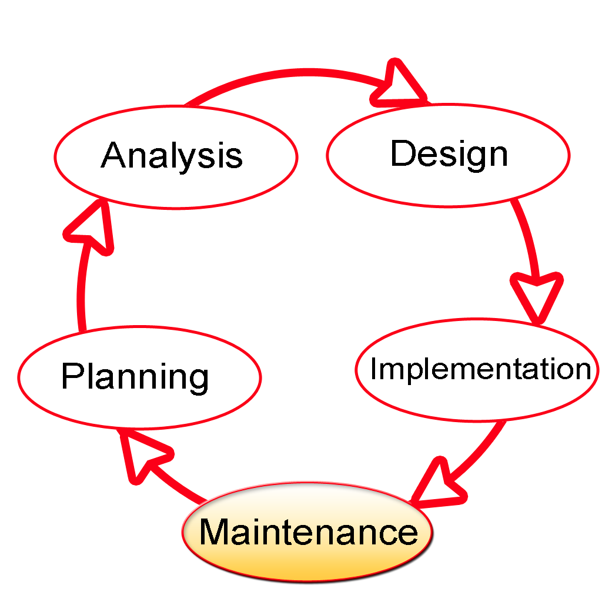
Systems Development Life Cycle
Entire process of developing a system

Slide 4

Systems Development Life Cycle
Can be generalized into 2 different approaches:
Predictive SDLC
Adaptive SDLC

Slide 5
Predictive and Adaptive SDLC
Predictive and Adaptive
Business Modeling
Intiation Phase (Intro)
Business Use Cases and Activity Diagrams
SDLC Phases

Slide 6
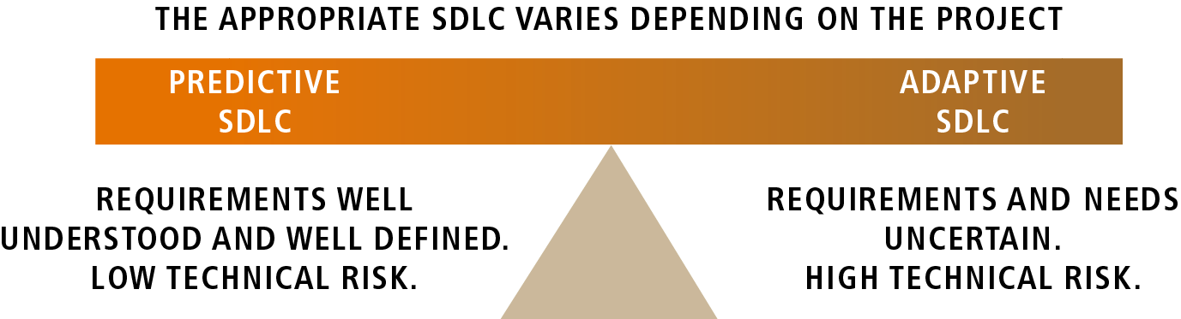
Predictive and Adaptive SDLC

Slide 7

When to use Predictive SDLC?

Slide 8
When to use Adaptive SDLC?

Slide 9
SDLC in Practice
New approaches evolved (together with object-oriented approaches)
More traditional
Predictive
SDLC
Adaptive
SDLC
1970s
1980s
1990s
21st Century

Slide 10

SDLC in practice
Any project you work with will have some predictive and some adaptive element

Slide 11
Traditional (predictive) SDLC Phases
Project Planning Phase
Analysis Phase
Design Phase
Implementation Phase
Support Phase
Planning Specifications frozen
Analysis Specifications frozen
Design Specifications frozen
Finished system delivered
exactly as specified

Slide 12
Traditional SDLC

Slide 13

Project Planning Phase
Ensure that the project is feasible
Identify scope of new system
Develop schedule, resource plan, budget etc

Slide 14

Analysis Phase
Understand the document in detail
Process requirements of the new system

Slide 15

Design Phase
Design system based on the requirements

Slide 16

Implementation Phase
Build system (includes acquire components)
Testing

Slide 17

Support Phase
Ensure the system is running properly during the lifetime of the system
Fix any issue that arises

Slide 18
Adaptive SDLC

Slide 19
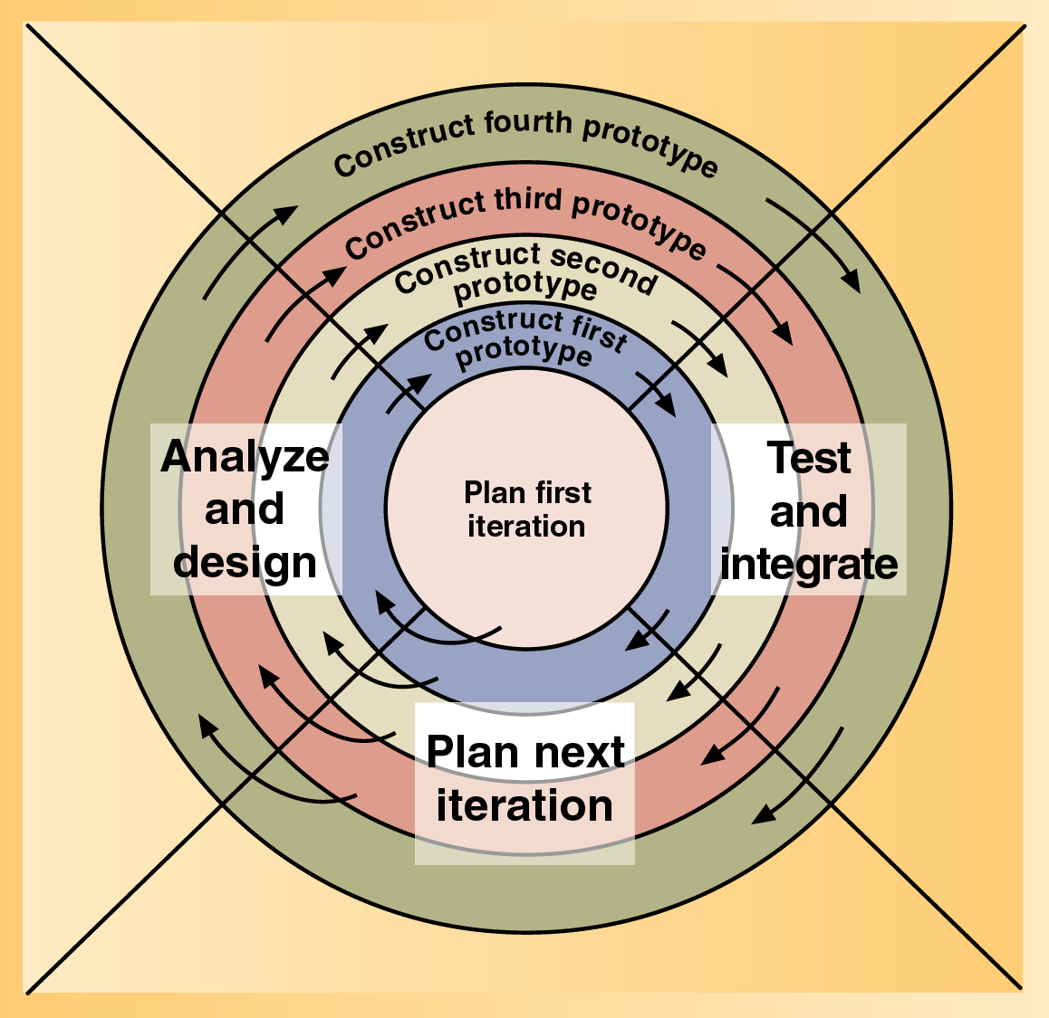
Idea of Adaptive SDLC
Contains many activities
Spiral Model
Start from the center and work its way outwards
Working over and over …. (until the project is finished)

Slide 20

Adaptive SDLC

Slide 21

In programming we often use the idea of Divide and Conquer to solve a big problem

Slide 22
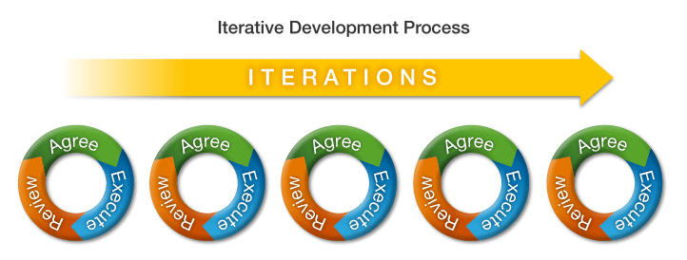
Iteration
Apply the Divide and Conquer idea to system development

Slide 23
Iterative (adaptive) Approach to SDLC
Some Analysis
Some Design
Some Implementation
More Analysis
More Design
More Implementation
Even More Analysis
Even More Design
Even More Implementation

Slide 24
An Example of Adaptive SDLC
The Unified Process Life Cycle

Slide 25
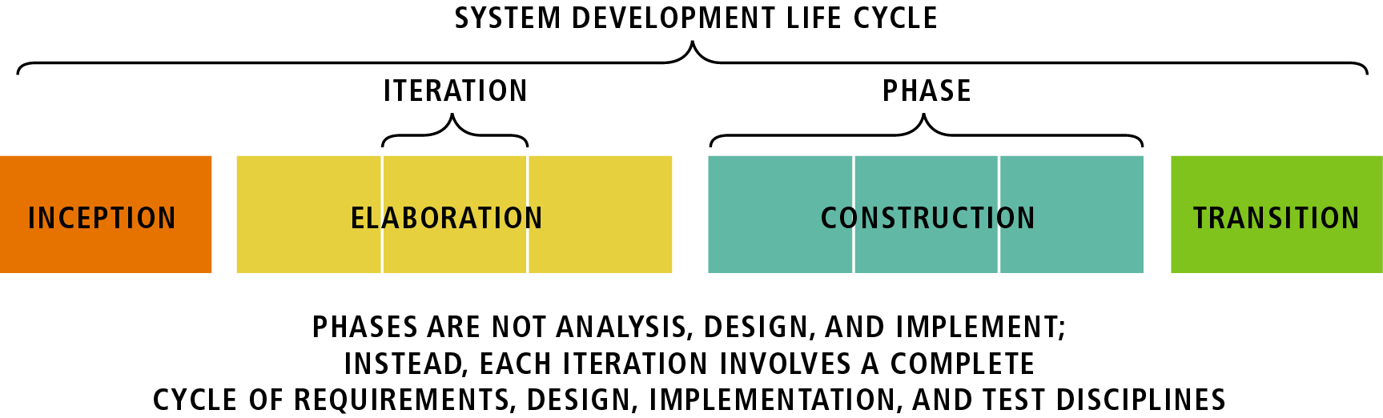
The Unified Process Life Cycle
Four phases: Inception, Elaboration, Construction, and Transition

Slide 26

Develop approximate vision for the project, define scope, cost/schedule estimate, etc
Notes:
Khởi đầu

Slide 27

Elaboration
Refine vision, identify and describe all requirements, design system, etc
Notes:
Công phu

Slide 28

Construction
Implement System

Slide 29

Transition
Testing, Deployment, Train users, etc

Slide 30
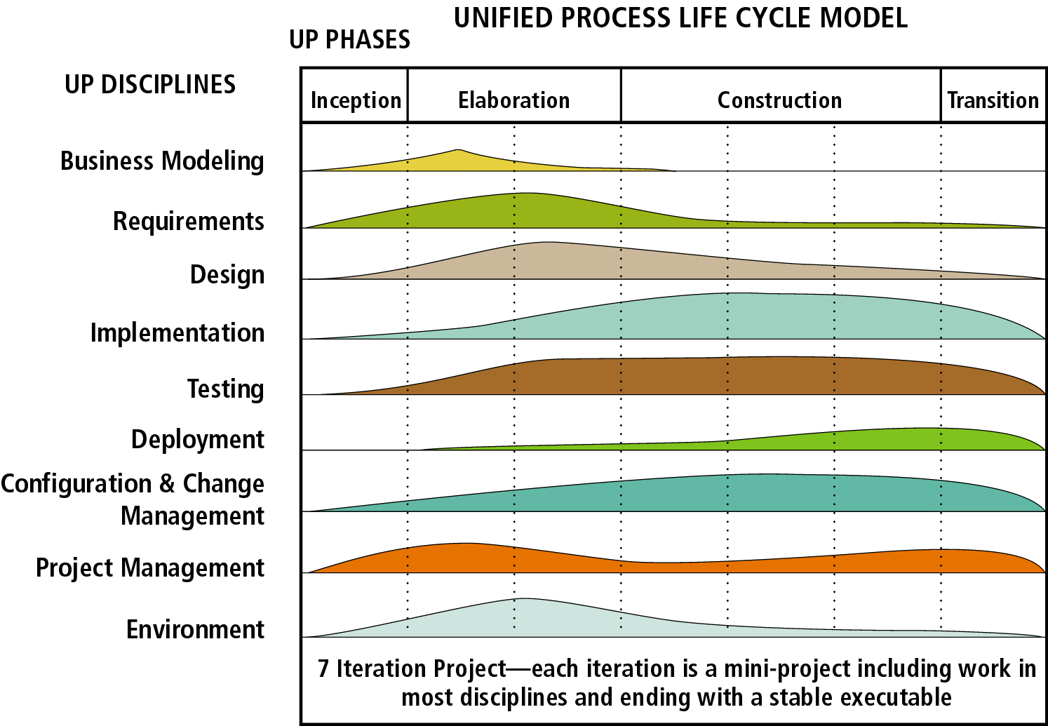
UP Phases and Objectives
Notes:
Engineering (Development) Disciplines:
Business Modeling
Requirements
Design
Implementation
Testing
Deployment
Support Discipline:
-Configuration & Change Management (tracking versions, manage change requests, etc)
-Project Management (Project Planning, What to do in the different iterations, milestones, etc)
-Environment (tools required for software development – IDEs, etc)

Slide 31
SDLC Phases
Predictive and Adaptive
SDLC Phases
Business Modeling
Intiation Phase (Intro)
Business Use Cases and Activity Diagrams

Slide 32

Phases
We can generalize SDLC into 5 different phases:
Initiation
Discovery
Construction
Final Verification and Validation
Closeout
Notes:
Closeout: đóng cửa

Slide 33

Initiation
Start of a new project.
Includes Business Modeling discipline

Slide 34
Recall: Development disciplines
Business Modeling
Requirements
Design
Implementation
Testing
Deployment

Slide 35
Business Modeling Discipline
Predictive and Adaptive
SDLC Phases
Business Modeling
Intiation Phase (Intro)
Business Use Cases and Activity Diagrams
Notes:
Kỷ luật
Huấn luyện

Slide 36

Business Modeling
Objective: Understand business environment and potential improvements
Objective: Communicate this understanding to the end users, manager, system developer, etc

Slide 37

Business Modeling
Purpose: Understand business environment
Document the Business Vision, the model of the business, etc

Slide 38
Phases
We can generalize SDLC into 5 different phases:
Initiation
Discovery
Construction
Final Verification and Validation
Closeout

Slide 39

Discovery
Can include some testing activities (validate idea)
Analyze and document requirements of project
Includes Requirements and Testing discipline

Slide 40

Construction
Includes Design, Implementation and Testing discipline

Slide 41

Final Verification and Validation
Includes Testing discipline

Slide 42

Closeout
Includes Deployment discipline

Slide 43
Initiation Phase (Intro)
Predictive and Adaptive
SDLC Phases
Business Modeling
Intiation Phase (Intro)
Business Use Cases and Activity Diagrams

Slide 44
Phases
We can generalize SDLC into 5 different phases:
Initiation
Discovery
Construction
Final Verification and Validation
Closeout

Slide 45
Initiation
Objectives:
Develop the business case of the project
Establish Project/Product scope
Explore solutions (Preliminary)

Slide 46
Initiation
1st problem:
Without knowing the requirements, how to estimate the cost?!
Solution:
Do just enough research to give a rough estimate

Slide 47

Initiation
Identify and analyze business requirements
Identify high-level business goals as business use cases (Modeling)

Slide 48
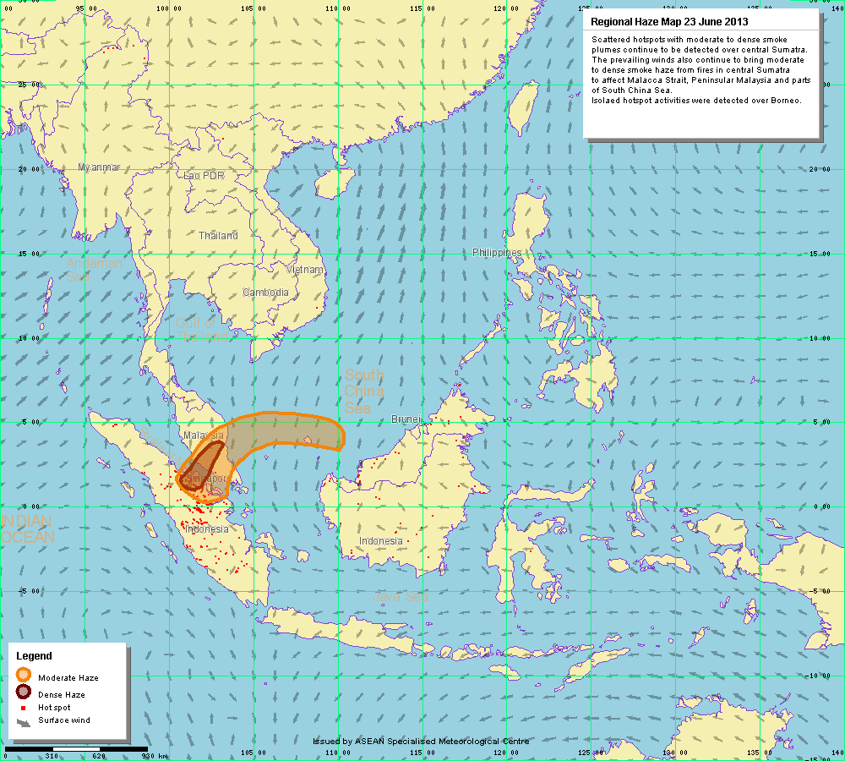
Recall: Models
Equations, Diagrams, Charts etc
Abstract representation of an aspect of real-world

Slide 49
2 ways to do modeling
Behavioral Modeling
Structural Modeling

Slide 50
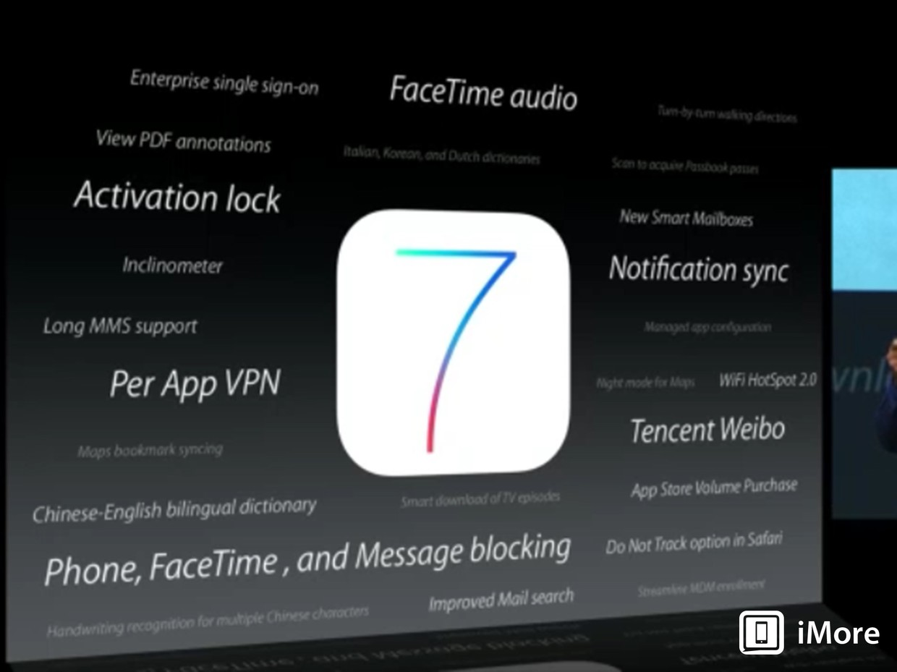
Behavioral Modeling
What does the system do?
What are the features?

Slide 51
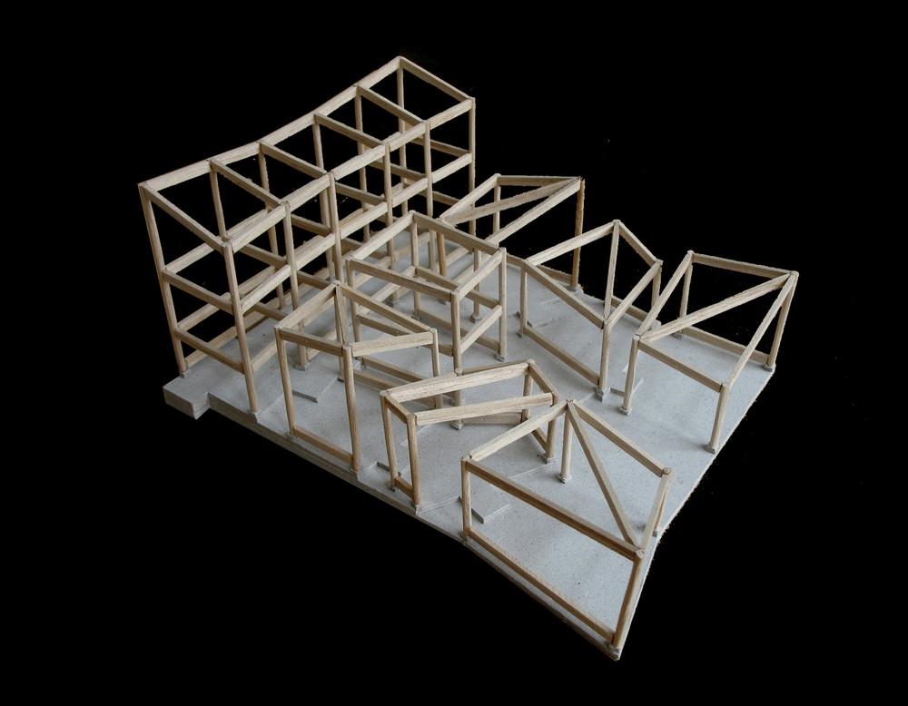
Structural Modeling
What is the system?
What are the components?

Slide 52
Artifacts of Behavioral (Dynamic) Model
Activity (workflow) diagrams
State-machine diagrams
Timing diagrams
System use-case diagrams
Business use-case diagrams
Sequence diagrams
Communication diagrams
Use-case descriptions (or use-case specifications)
Decision tables
Decision trees

Slide 53

Artifacts of Behavioral (Dynamic) Model
Activity (workflow) diagrams
State-machine diagrams
Timing diagrams
System use-case diagrams
Business use-case diagrams
Sequence diagrams
Communication diagrams
Use-case descriptions (or use-case specifications)
Decision tables
Decision trees

Slide 54
Artifacts of Behavioral (static) Model
Class diagrams
Package diagrams
Composite structure diagrams
Static object diagrams

Slide 55

Recall: UML
Unified Modeling Language (UML)
Standard set of model constructs
Designed for Object-Oriented Development

Slide 56
Diagrams
Use UML techniques for drawing models (diagrams)
Business use cases: Identifying and describing end-to-end business processes
Activity diagram: Understand the workflow of each business use case
Actors: Users and/or external systems that will interact with the proposed IT system
System use cases: Describes the functionality of the System

Slide 57
Deliverables
A single document: Business Requirements Document (BRD)
Describe business requirements
The BRD will be revised as the project progresses
Key components of the BRD produced during the Initiation phase include:
Business use-case descriptions include business use-case diagrams
Role map
System use-case diagram
Initial class diagram describing key business classes

Slide 58
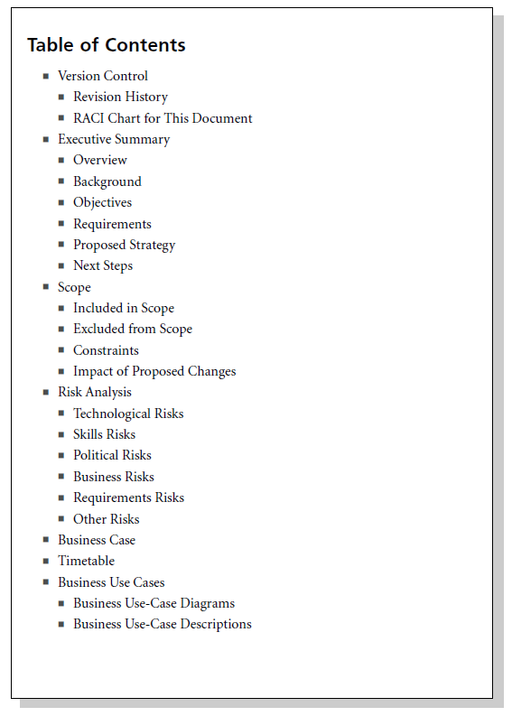
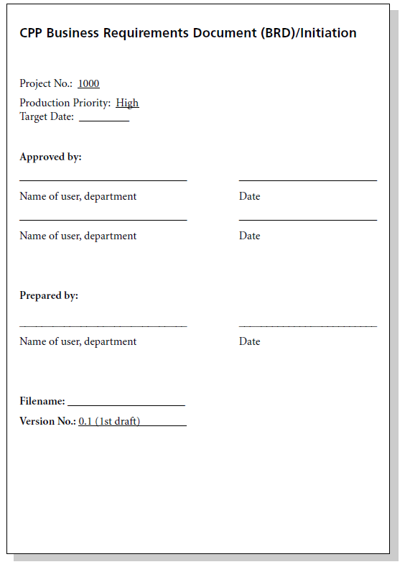

Slide 59

Steps in Initiation Phase
1. Model business use case
Identify business use cases (business use-case diagram)
Scope business use cases (activity diagram)

Slide 60
Steps in Initiation Phase
2. Model system use case
Identify actors (role-map diagram)
Identify system use cases (activity diagram)

Slide 61
Steps in Initiation Phase
3. Set baseline for discovery
Baselining allows you to see what the requirements looked like at various checkpoints

Slide 62
Business Use Cases and Activity Diagrams
Predictive and Adaptive
SDLC Phases
Business Modeling
Intiation Phase (Intro)
Business Use Cases and Activity Diagrams

Slide 63
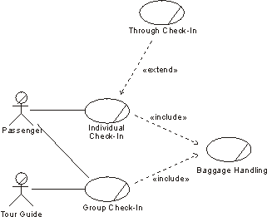
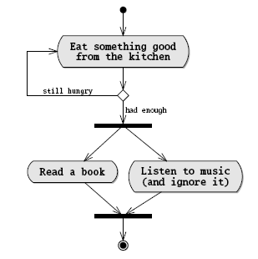
Model Business Use Cases
Identify business use cases (business use-case diagram)
Scope business use cases (activity diagram)

Slide 64
Identify Business Use Cases
A business use-case diagram provides an overview of business processes and the entities involved in the processes

Slide 65
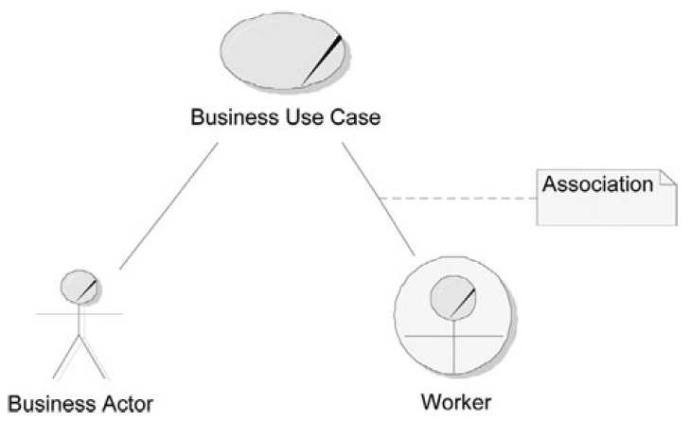
Example of a Business Use-Case Diagram
Business actor: someone external to the business
Worker: someone who works within the business
Association: indicates that the actor interacts with the business over the course of the business use case

Slide 66
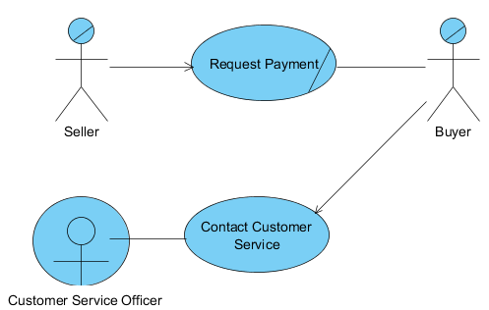
Simple Ebay Case Study
Notes:
Can draw more business use cases in this diagram

Slide 67
So what does business use case diagram model?

Slide 68
How to model the workflow?

Slide 69
Activity Diagrams
Workflow can be documented in text and/or through the use of a workflow diagram (Activity diagram)

Slide 70
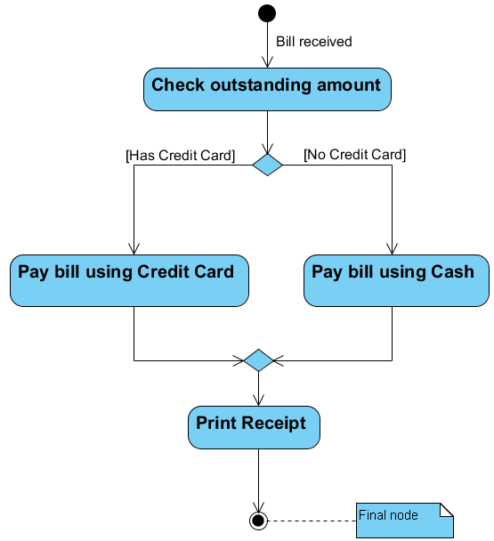
Activity Diagrams Elements
Initial node: indicates where the workflow begins
Activity: indicates a step in the process. Notice anything about the typical naming convention?
Control flow: an arrow showing the direction of the workflow
Decision: a diamond symbol, indicating a possibility of different paths
Guard condition: a condition attached to a control flow. A guard is shown within square brackets
Merge: model a number of alternative flows that lead to the same activity
Notes:
Activity naming is usually verb-based

Slide 71
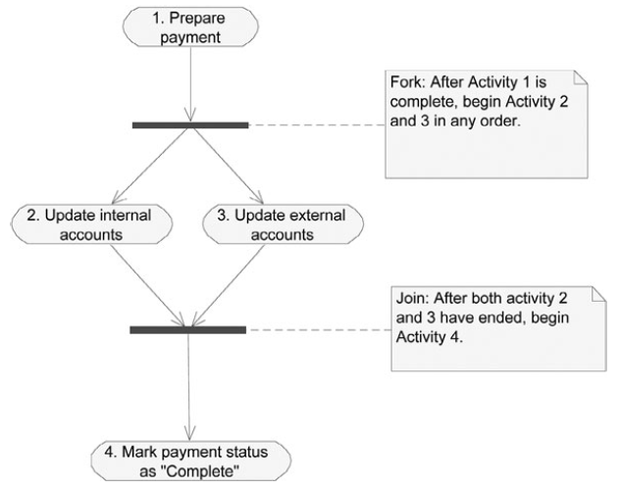
Activity Diagrams Elements
Fork and Join: bars used to document parallel activities.
Is there any difference between join and merge?

Slide 72
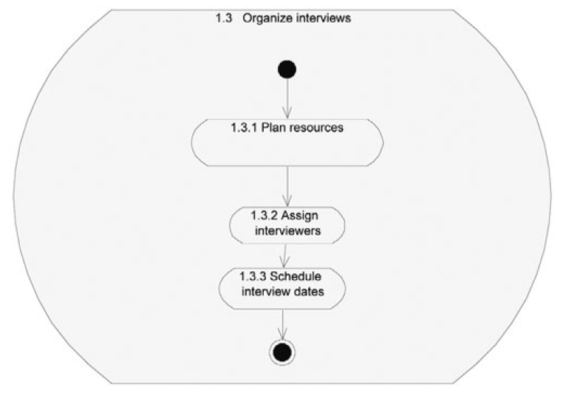
Nested Activities

Slide 73
Object-Oriented (OO) Paradigm

Slide 74
Object-Oriented (OO) Paradigm
Different types of programming paradigms:
Structured Programming
Use of if/else, loops instead of goto statements
E.g. C
Functional Programming (Declarative programming)
Call functions to do something
E.g. Haskell, ML, Scheme, SQL
Object-Oriented Programming
Think in terms of objects, attributes are features of the object, and methods are operations of the object
Java, C++, C#, Objective C

Slide 75
Object State
Objects may be considered to be in various state during their lifetimes
Example
invoices pass through some of the following states “Created”, “Due”, “Paid”, “Past 30 Days”, “Written Off”

Slide 76
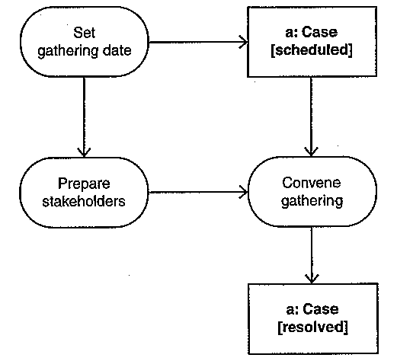
Object State
Indicating object flows on activity diagrams

Slide 77
Object
Name the object according to the format <objectName>: <ClassName> <[statename]> - for e.g., a: Case [resolved]
You may omit objectName – for example :Case [resolved]
ou may omit the statename – for example, a:Case
Notes:
The object that is required, or altered by an activity. Name the object according to the format <objectName>: <ClassName> <[statename]> - for example, a: Case [resolved].
You may omit objectName – for example :Case [resolved].
As well, you may omit the statename – for example, a:Case
An object may be a source or destination of an object flow, or both.
One activity diagram may include objects of many classes and different objects of the same class.
As well, the same object may appear more than once on an activity diagram.
If an activity produces an object as output, and this same object is the input for the next activity, you may omit the control flows between the two activities

Slide 78
Object
An object may be a source or destination of an object flow, or both
May include objects of many classes and different objects of the same class
Same object may appear more than once

Slide 79
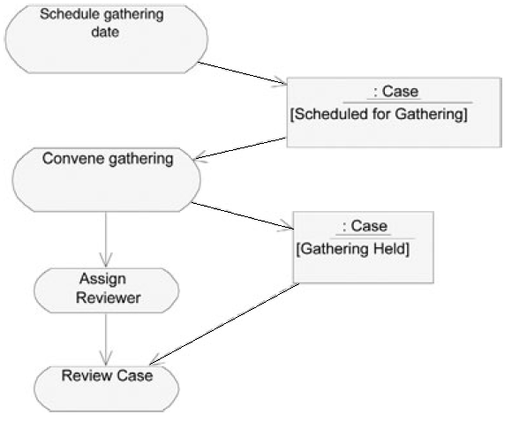
Activity Diagram with Object Flows

Slide 80
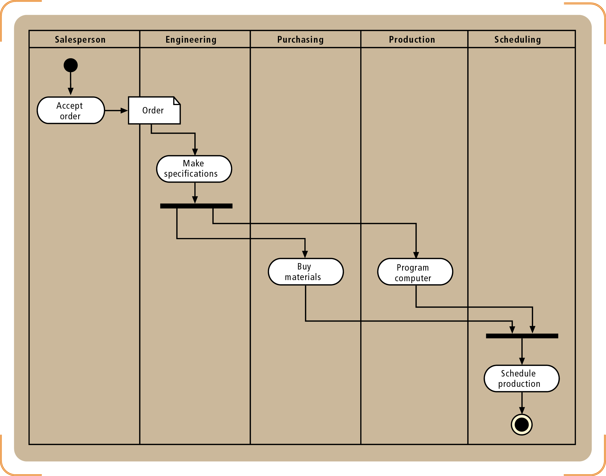
Activity Diagram with Partition (Swimlanes)
:Order

Slide 81
What’s Next?
Events Decomposition
System Use Case Diagrams

